Slide 1
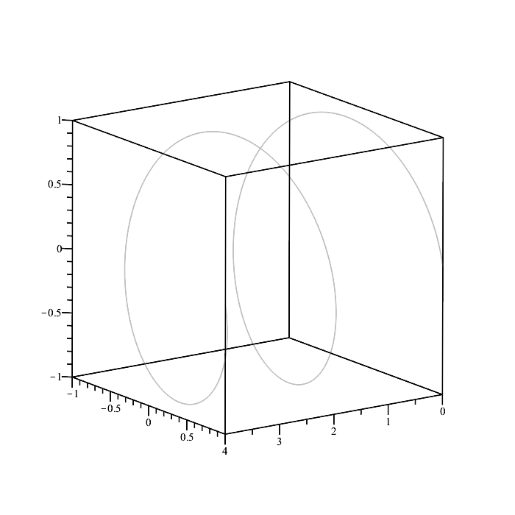





$$O$$
$$\overset{⃑}{q}(t)$$
$$\overset{⃑}{r}(t)$$
$$\overset{⃑}{h}(t)$$
$$\overset{⃑}{s}(t)$$

Slide 2






$$d_{w}$$
$$r_{M,w}$$
$$d_{e}(ε_{0})$$
$$d_{w}$$
$$r_{M,e}$$
$$d_{e}(ε_{max})$$

Slide 3



$$d_{w}$$
$$r_{M,e}$$
$$d_{e}(ε_{0})$$

